Slide 1
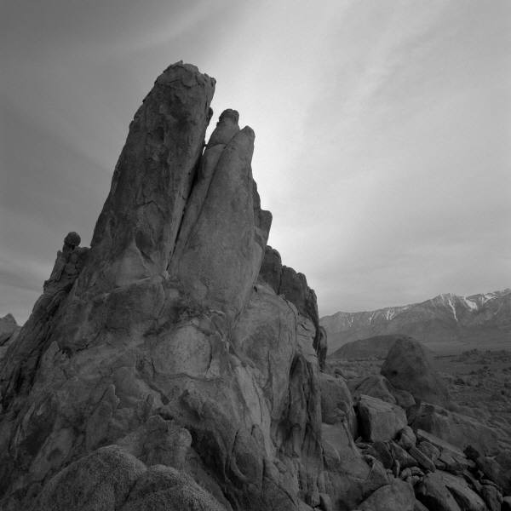
ALAMIN. GAMITIN!
TALASALITAAN
DAPAT MALAMAN!

Slide 2
Square root

Slide 3
MILLION

Slide 4
QUESTIONNAIRE

Slide 5
DESIGN

Slide 6
CONGRATULATIONS

Slide 7
KEYCHAIN

Slide 8
INAUGURATION

Slide 9
PRODUCTIVITY

Slide 10
TO EXCHANGE
SEATS

Slide 11
ENGINEER

Slide 12
TO CHANGE
THE SUBJECT

Slide 13
MUSIC
SHEET

Slide 14
GUITAR
PICK

Slide 15


Slide 16


Slide 17


Slide 18


Slide 19


Slide 20


Slide 21


Slide 22


Slide 23


Slide 24


Slide 25


Slide 26


Slide 27


